Slide 1



Project Short Summary
This project employs advanced statistical methodologies to meticulously analyze global COVID-19 mortality rates. Focusing on identifying specific conditions and comorbidities that significantly impact outcomes, we aim to provide comprehensive insights. These insights are crucial for refining public health strategies, optimizing resource allocation, and implementing targeted interventions to combat the pandemic effectively. By leveraging rigorous analysis and stakeholder engagement, our goal is to empower healthcare decision-makers with actionable data to mitigate COVID-19's impact and enhance global health outcomes.
COVID-19 DEATH CONDITIONS ANALYSIS
COVID-19 mortality analysis project effectively utilizes advanced statistical methodologies to delve into global mortality rates, focusing on pinpointing specific conditions and comorbidities influencing outcomes. This analysis aims to deliver actionable insights crucial for refining public health strategies and optimizing resource allocation in our fight against COVID-19. Moving forward, enhancing transparency in our methodologies and fostering deeper stakeholder engagement will be key to maximizing our project's impact on healthcare decision-making and pandemic management efforts.
Sai Krishna Rao Kaveliga
saikrish230503@gmail.com
Joginpally BR Engineering College(JBREC)
#skillsbuild

Slide 2
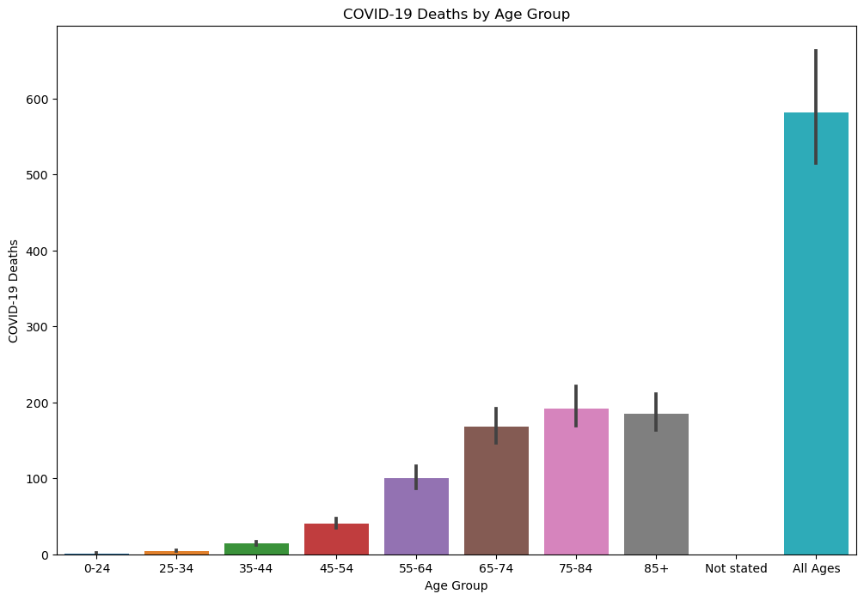
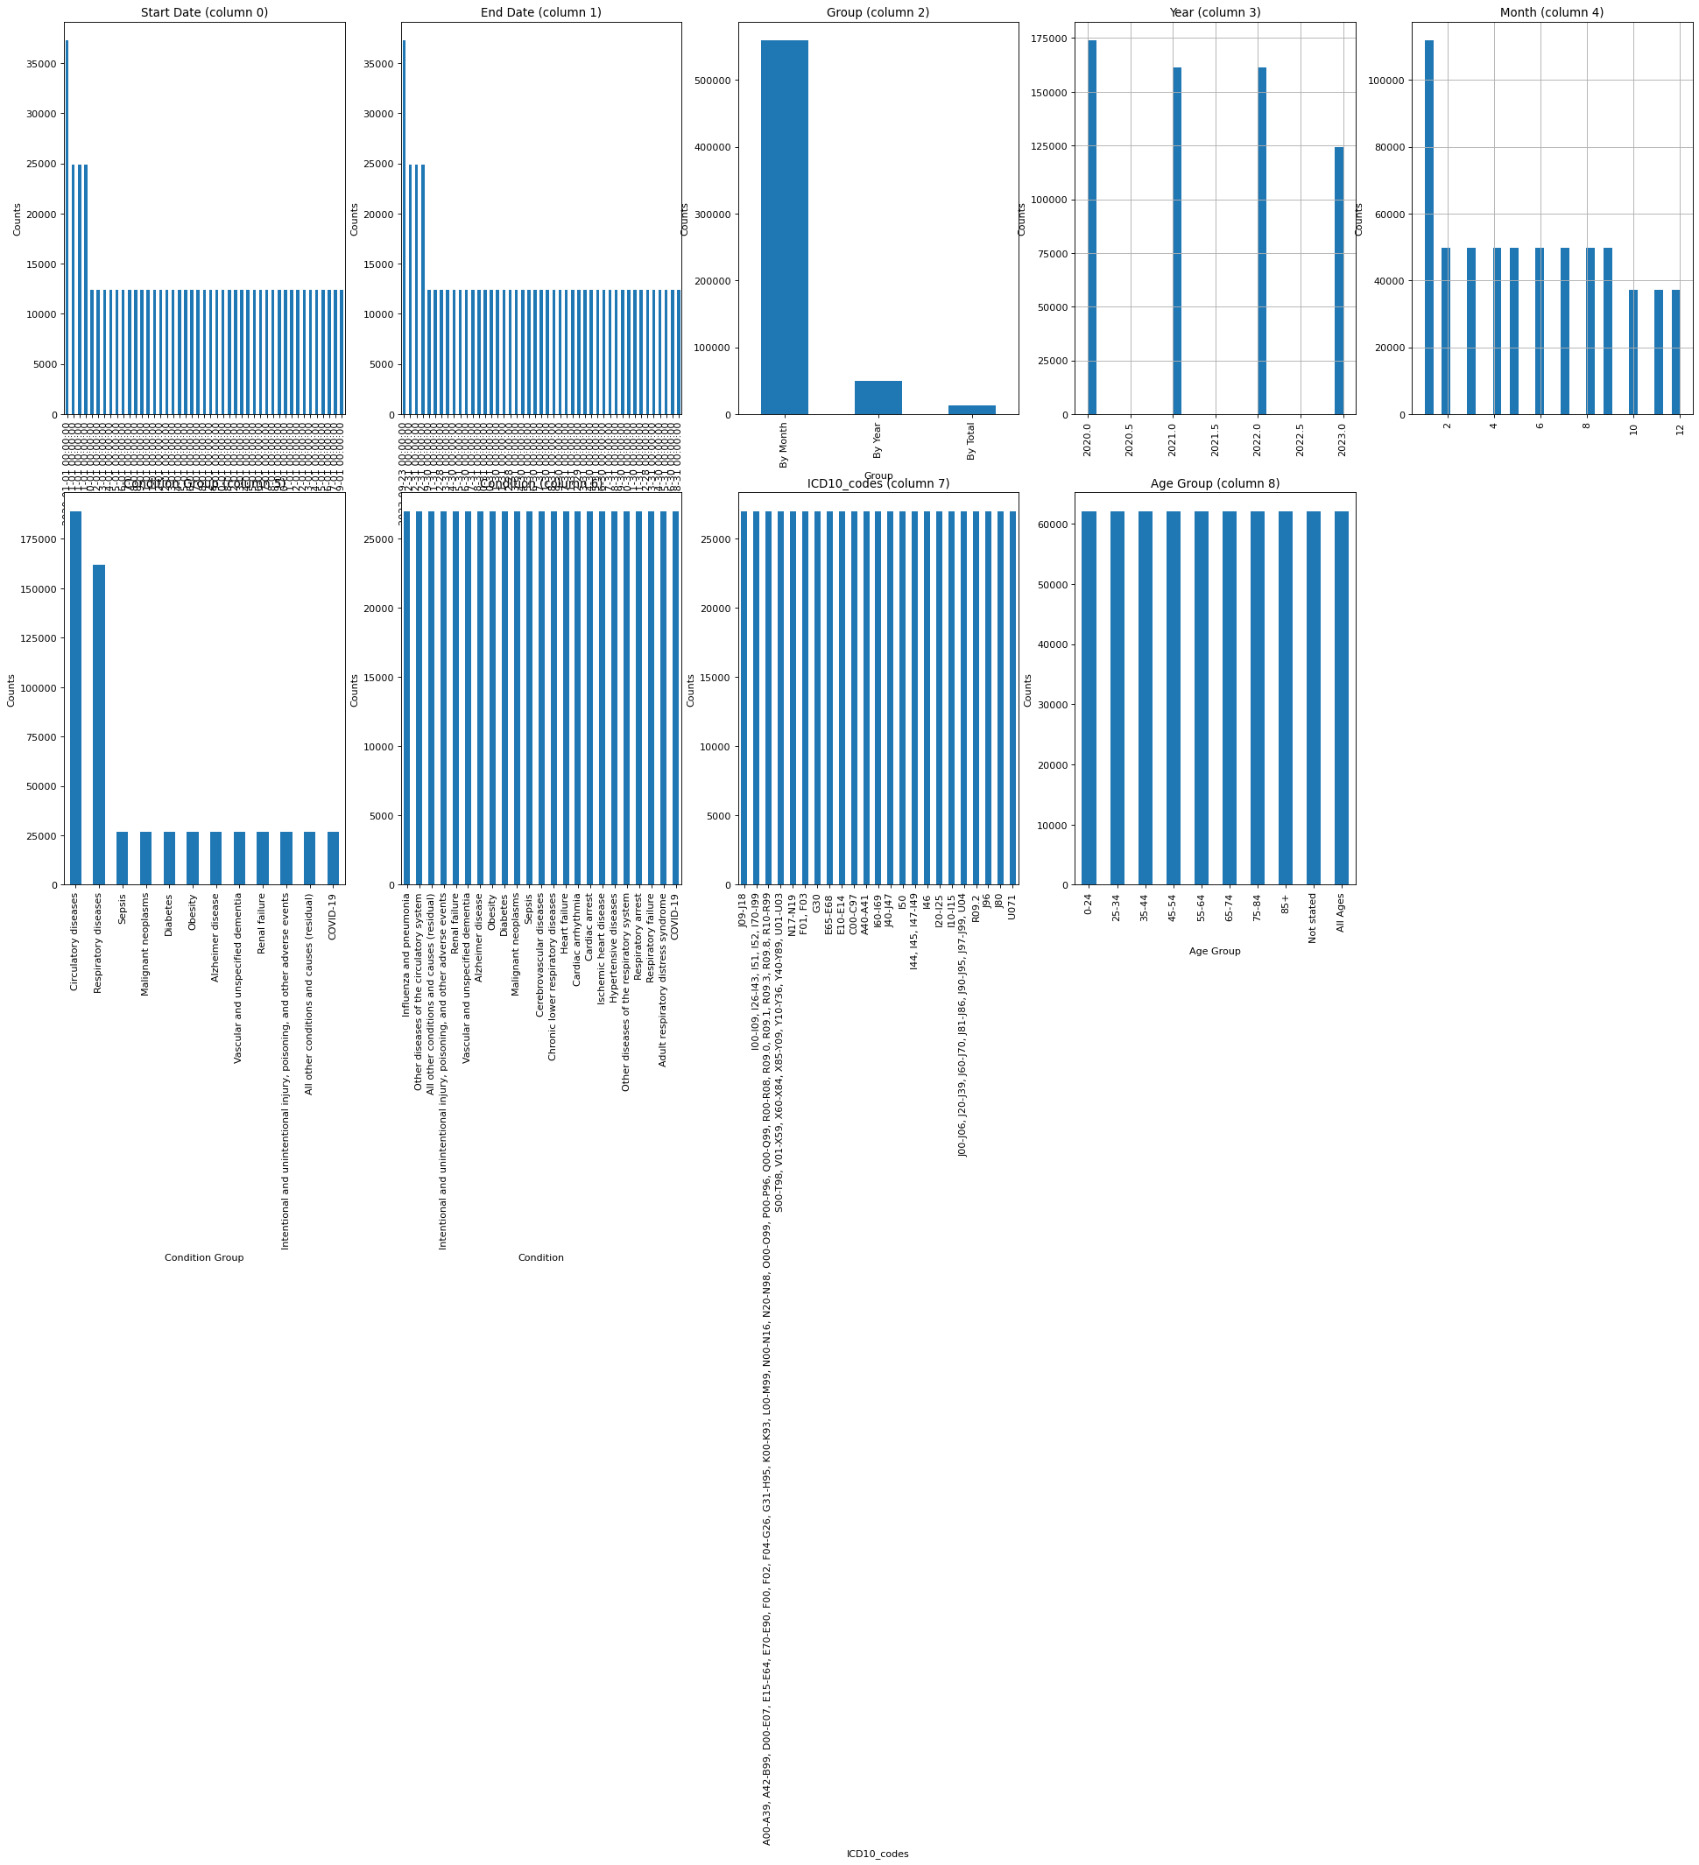
Final Project Outcome Screenshot

Slide 3
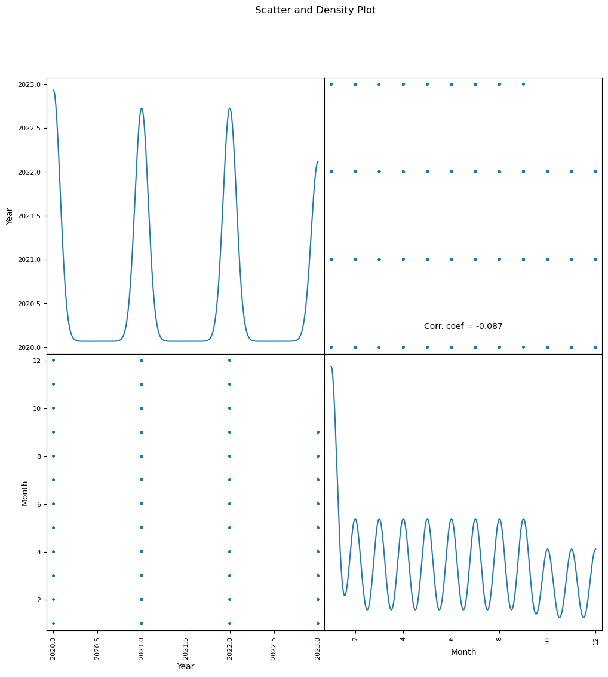
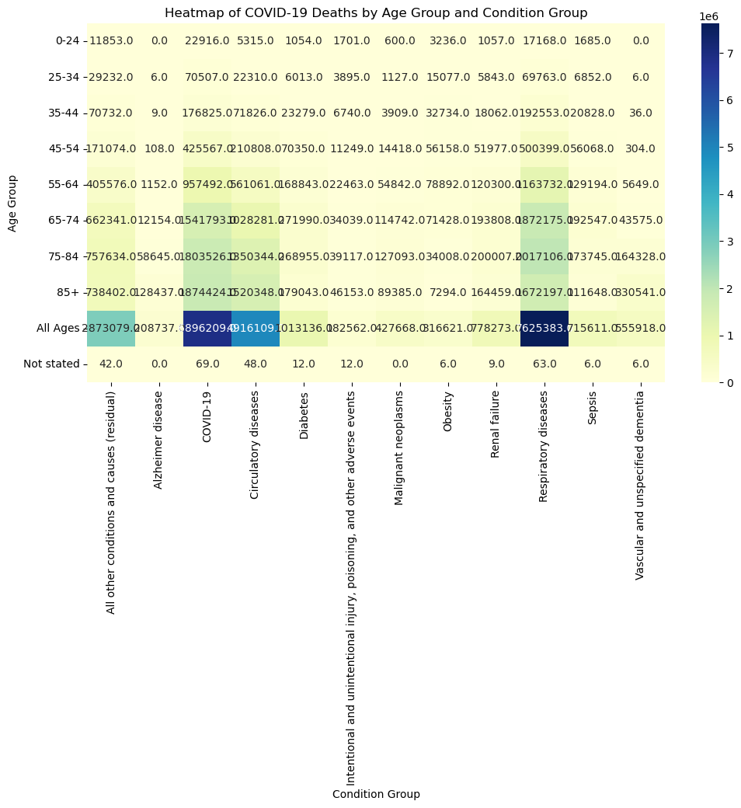
Final Project Outcome Screenshot

